Slide 1

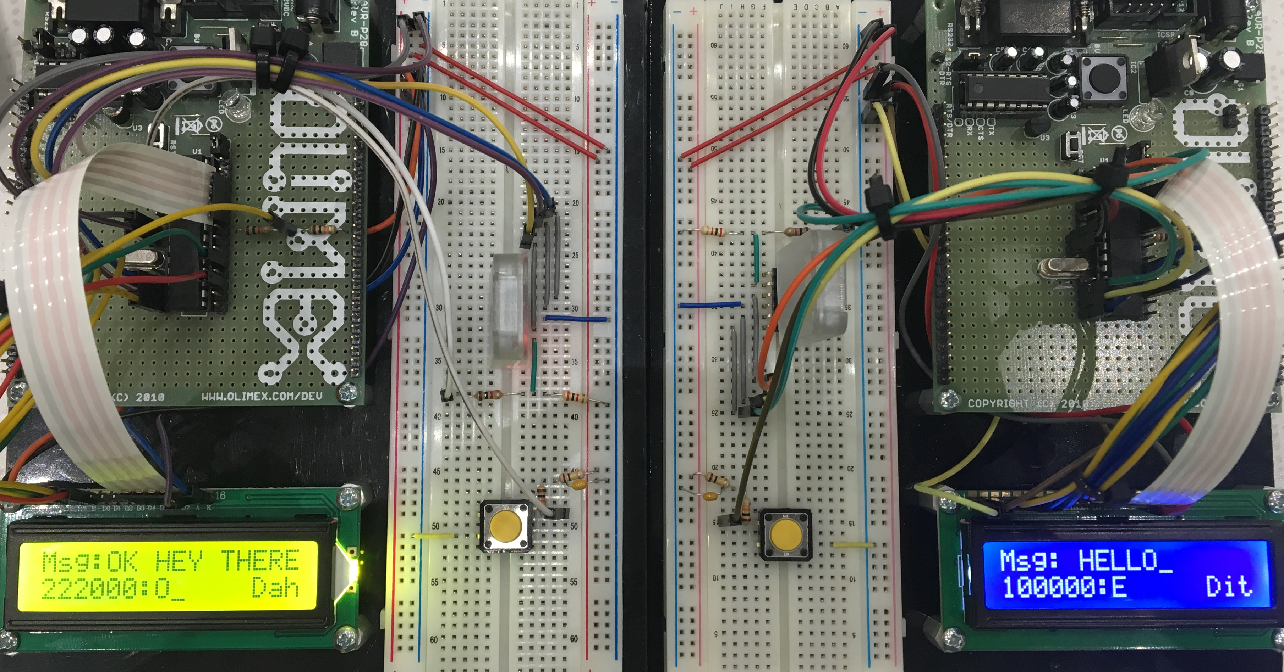
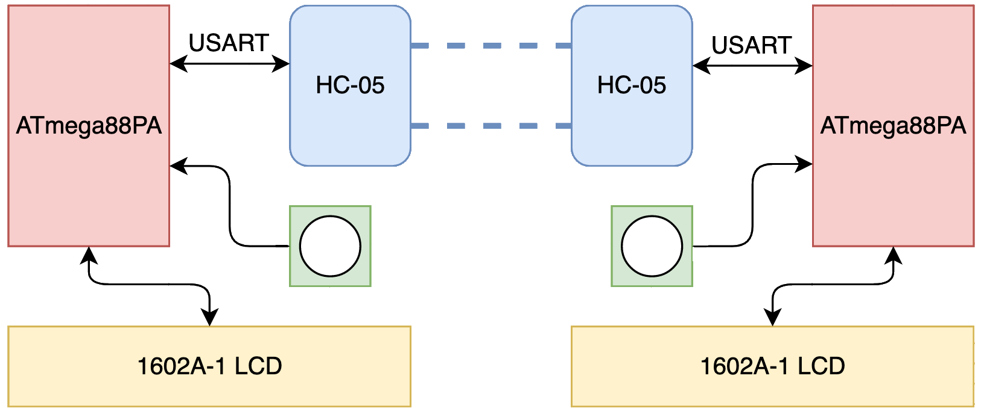
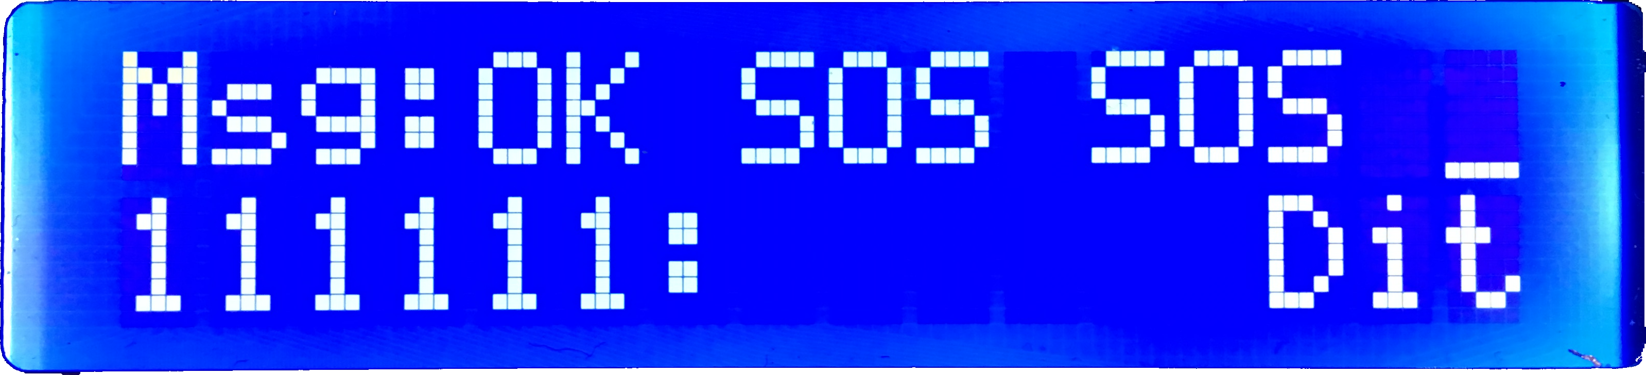
Morse Code Chat
23
Alexander Powers and Benjamin Mitchinson
Abstract
Our project was the design and creation of a discrete Morse Code communication system programmed on two ATmega88PA development boards. Using our solution, two users are able to communicate with one another by tapping out Morse Code on a button, which is then transmitted over Bluetooth to the LCD of the other user.
Image 1. Side by Side of the Two Devices
System Design
Result
Our project is able to consistently and accurately interpret and transmit Morse Code between devices, which are running the same program. The user experiences little delay between communications, because each character is transmitted as soon as it is entered. In order to create a robust product, we also used defensive programming techniques to ensure that users cannot enter an invalid state.
Figure 1. System Overview
The button is the primary input signal for the system, which the ATmega88PA detects and interprets through a timer interrupt. This decoded Morse Code is then sent via the USART communication protocol to the HC-05 Bluetooth module, which then forwards the message to the other board’s HC-05 module. Once received by the other ATmega88PA, the Morse code is displayed on the 1602A-1 LCD. The LCD also displays the current Morse Code bits, and the previous button press interpretation.
Image 2. User View During Use
Additionally, we were able to use the binding functionality of the HC-05 to ensure that message transmission will never be interrupted by another HC-05 Bluetooth module.
Lessons Learned
Conclusion
This project taught us the importance of quickly testing and reevaluating design choices. Multiple times in the course of this project we took wrong turns that were quickly corrected by testing programs that targeted individual smaller functionalities. This lesson of early testing and evaluation is something we will carry with us into our future engineering projects.
Our completed solution achieves exactly what we sought to accomplish. The pairing process of the HC-05 devices is faster and more reliable than originally anticipated, resulting in a consistent and accurate transmission of the Morse Code. We also designed our solution to be flexible to user tapping speed by allowing the Farnsworth unit to be changed to match the users preference. This project has sparked our interest in embedded systems, and we intend to convert this into a handheld, battery powered system over the summer!
Acknowledgments
USART Library (https://www.electronicwings.com)
LCD Library (http://tinyurl.com/peterfleury)
Farnsworth Unit (https://morsecode.scphillips.com/timing.html)
Standard AVR Libraries (interrupt.h/delay.h/io.h)
ECE:3360 Embedded Systems 2019
The University of Iowa

